Slide 1
NE FL CoC October 12, 2023
Duval | Clay | Nassau – FL 510

Slide 2
WELCOME CoC Members!
Notes:
Dawn and David – Will and Barbara

Slide 3
WELCOME New Staff Members!
Notes:
Dawn and David – Will and Barbara

Slide 4
LBGT+ History Month 2023
General Updates
Notes:
October 10th – World Homelessness Day
DV Awareness Month – National Coalition Against DV -- Take A Stand is a call to action meant to bring attention to the issue of domestic violence for Domestic Violence Awareness Month (DVAM) and throughout the year. By taking a stand we intend to remind the nation that there are still countless people--victims and survivors, their children and families, their friends and family, their communities--impacted by domestic violence. We, all of us, should not stop until society has zero tolerance for domestic violence and until all victims and survivors can be heard.
LGBTQ (lesbian, gay, bisexual, transgender, questioning) History Month is celebrated in October in observance of lesbian, gay, bisexual and transgender history as well as the history of gay rights and civil rights movements. LGBT History Month was first celebrated in 1994 and was founded by Missouri high school history teacher Rodney Wilson.

Slide 5
General Updates
Gearing up for yearend…
Memorial | December 21st
Point-In-Time | January 2024

Slide 6
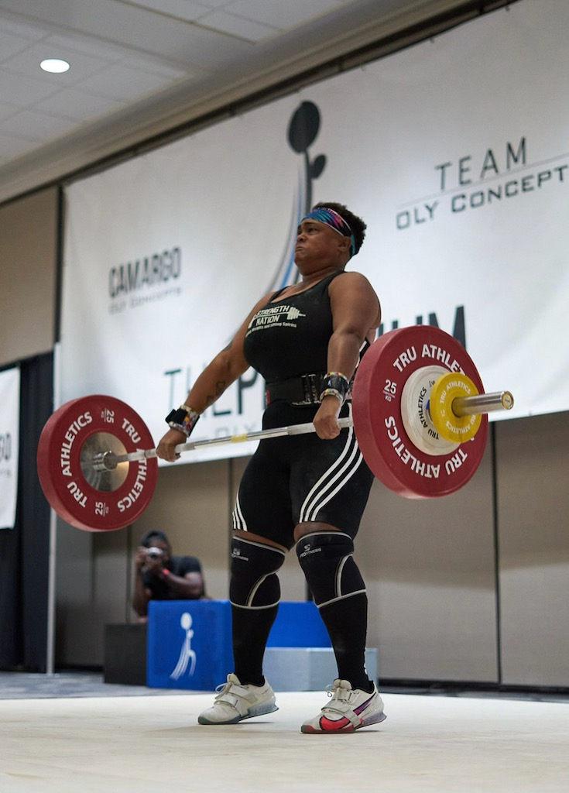
Outreach Updates
Outreach – Weekly Schedule
Duval
Monday, Wednesday and Friday – Urban Rest Stop
Tuesday – Salvation Army
Thursday – Downtown Clinic
Nassau
Tuesday and Friday – Day Drop In Center
Clay
Working with Clay County Community Services
Notes:
Outreach team is currently working in all Three Counties, Nassau, Duval and Clay
In Duval we are currently located at Urban Rest Stop every Monday, Wednesday and Friday. Salvation Army downtown every Tuesday. And every Thursday we are at a local clinic in the downtown area that sees several homeless individuals. And every Tuesday and Friday we are in Nassau County at the Day’s Drop of center.
We are currently working to establish a stronger connection and presence in Clay County by partnering and working with Clay County Community Services that is in Middleburg, FL. The goal is to establish outreach services in the community so we can start doing and enrolling people that are in need into coordinated entry. That connection and collaboration should be up an running in the next few weeks.

Slide 7
Outreach Updates
Outreach – We’ve got this!
Looking for outreach opportunities and organizations
Join us on at 9 am Monday morning for our weekly By Names List chat
Notes:
The outreach team is always looking for other opportunities and other organizations to work with to do outreach and to reach those in need.
We invite any and everyone who would like to be part of our Monday morning By Names List meeting that happens at 9am every Monday.

Slide 8
Outreach Updates
Outreach & CES
Contact Info:
Outreach: outreach@changinghomelessness.org
Coordinated Entry : ces@changinghomelessness.org
By phone : 904-354-1100

Slide 9
HMIS Updates
Did you know?
HMIS Data Standards Update Training | https://youtu.be/4VJmaFMl4Co
Show the Way Application

Slide 10
What’s new with YOU?
Events & Announcements

Slide 11
Events & Announcements

Slide 12
Events & Announcements

Slide 13
Questions?

Slide 14
Thank you!

